Slide 1
Exploring of Discover, Design and Monitor

Slide 2
Table of Contents
1
Exploring Discover
2
Exploring Design
3
Exploring Monitor
4
Creation of Package
5
Pre-package Content Configuration

Slide 3
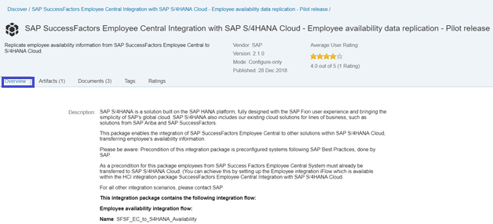
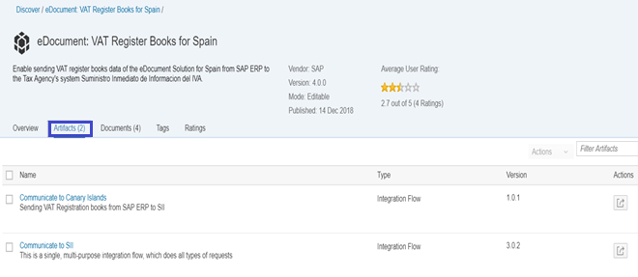
1.Exploring Discover
Discover contains Standard Integration Content published by SAP and its Vendors. All the packages are specific to the Business process.
Components of Pre-Package
Overview:
This contains the description of Systems and the Integration between them.
Artifacts:
Integration flows for various business process are added within Artifacts.
Other information's are available within overview are Integration flow, Package ID, Category and Created date.
Other components available under artifacts are OData Service, Value Mapping and Data integration.
We can view the steps within the Integration flow from Artifacts

Slide 4
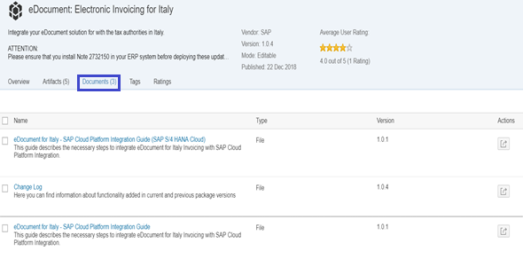
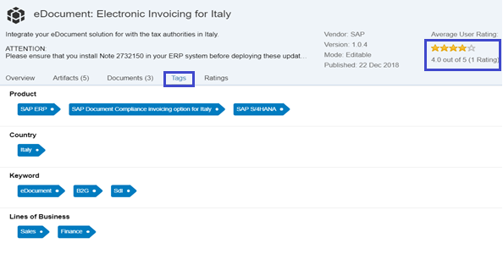
1.Exploring Discover
Documents:
Integration Guide is provided for some package with step by step process under Documentation section.
PDF Document can be downloaded. Changes for the package is maintained in Change Log and added in Documents Tab.
Tags:
Packages are tagged with the Key words like Product, Country, Line of Business.
Ratings:
Consumer Ratings and Comments for the are Standard content are added in Ratings

Slide 5
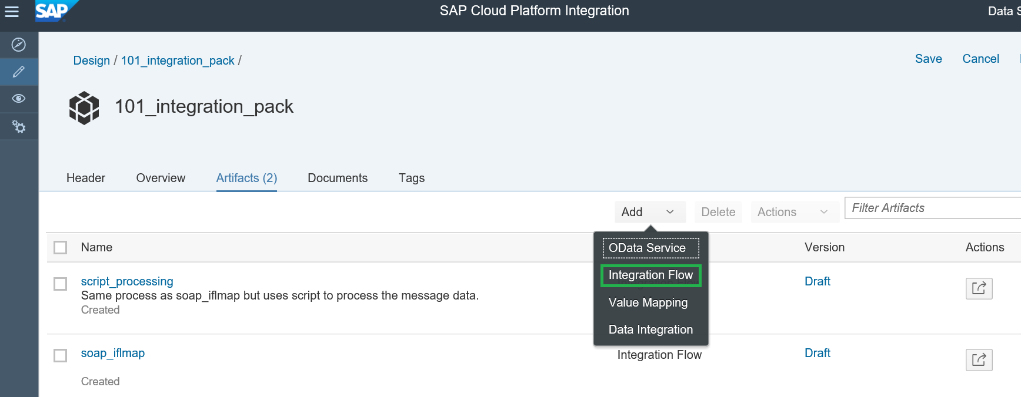
3.Exploring Design
Design enables the developer to create/Edit Packages and Artifacts. Various palettes functions are available as standard which can be used to complete Business Process.
Security materials such as Certificates, Credentials, Keys imported in Operations are internally used Iflow.
Artifacts
Integration Flow
OData Service
Value Mapping
Data Integration

Slide 6
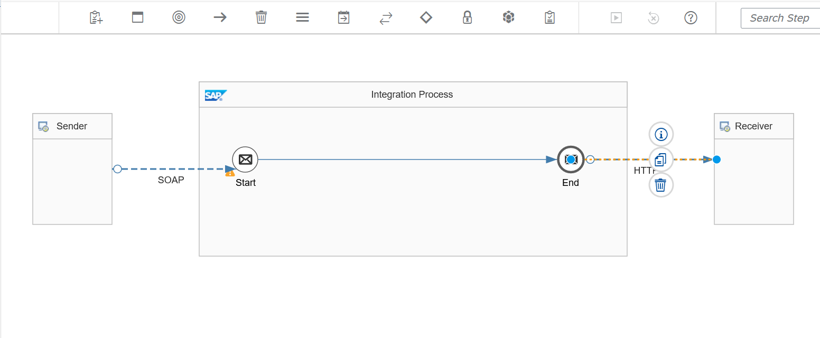
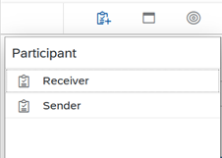
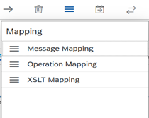
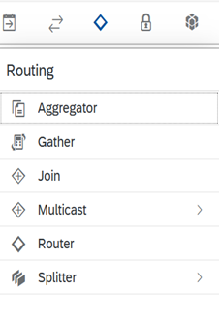
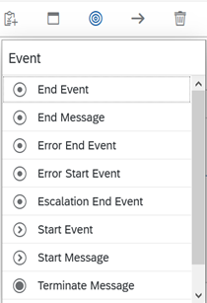
3.Exploring Design
Integration Flow
Few sample palettes

Slide 7
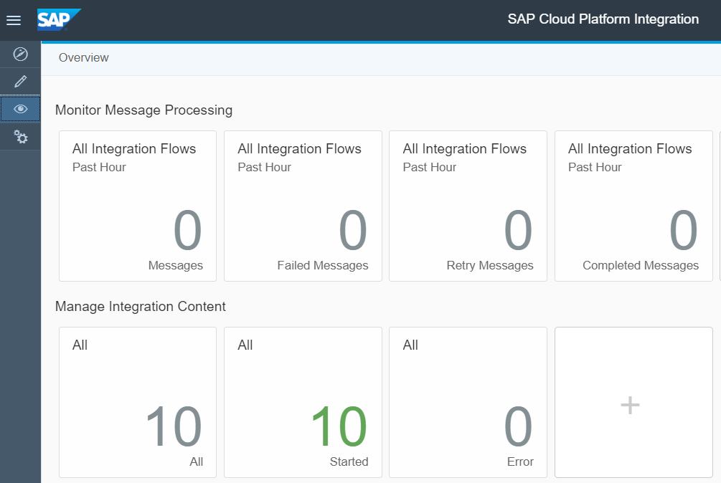
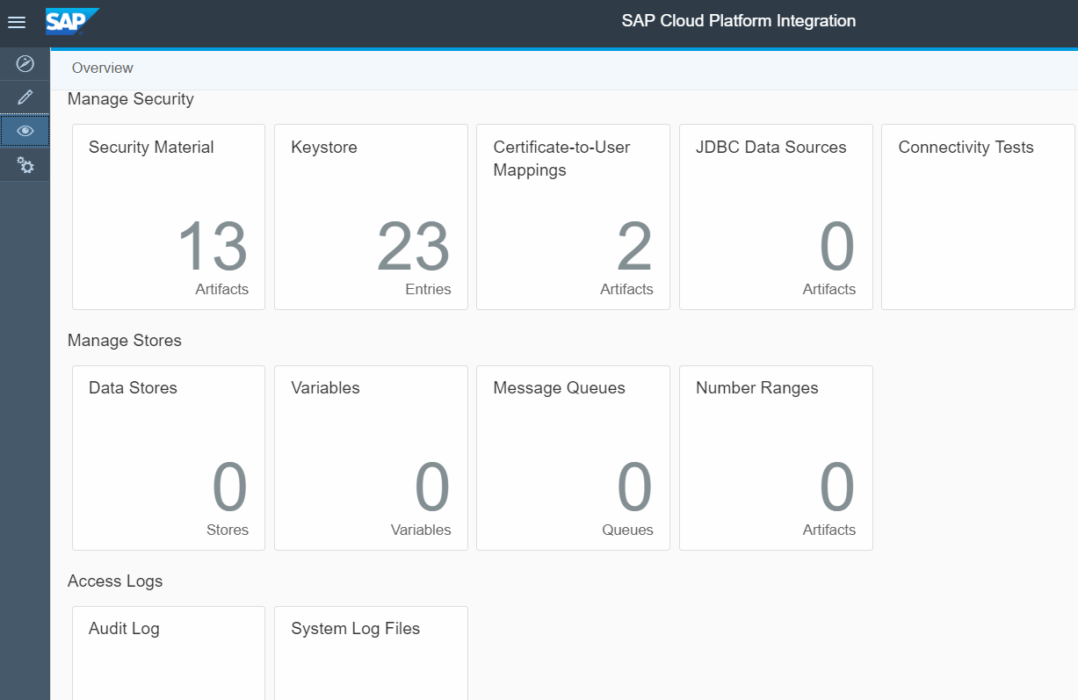
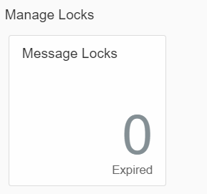
4. Exploring Monitor
Message and Integration Content Monitoring
Manage Security and Manage Stores
Manage Locks

Slide 8
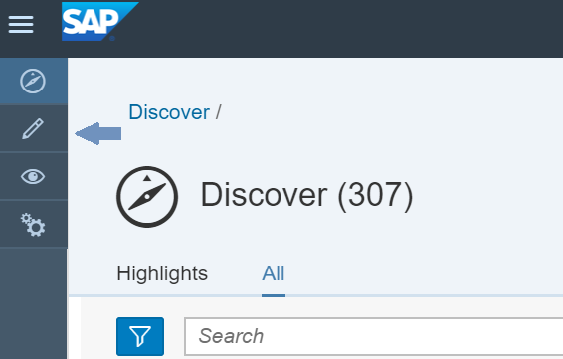
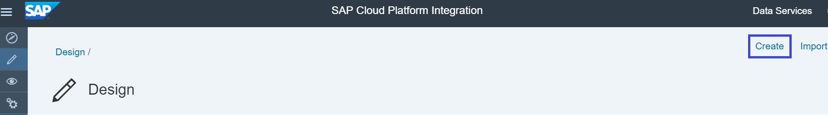
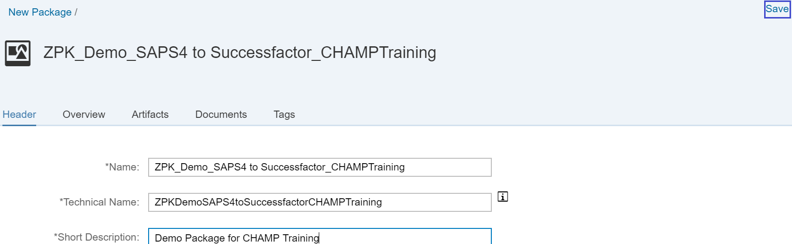
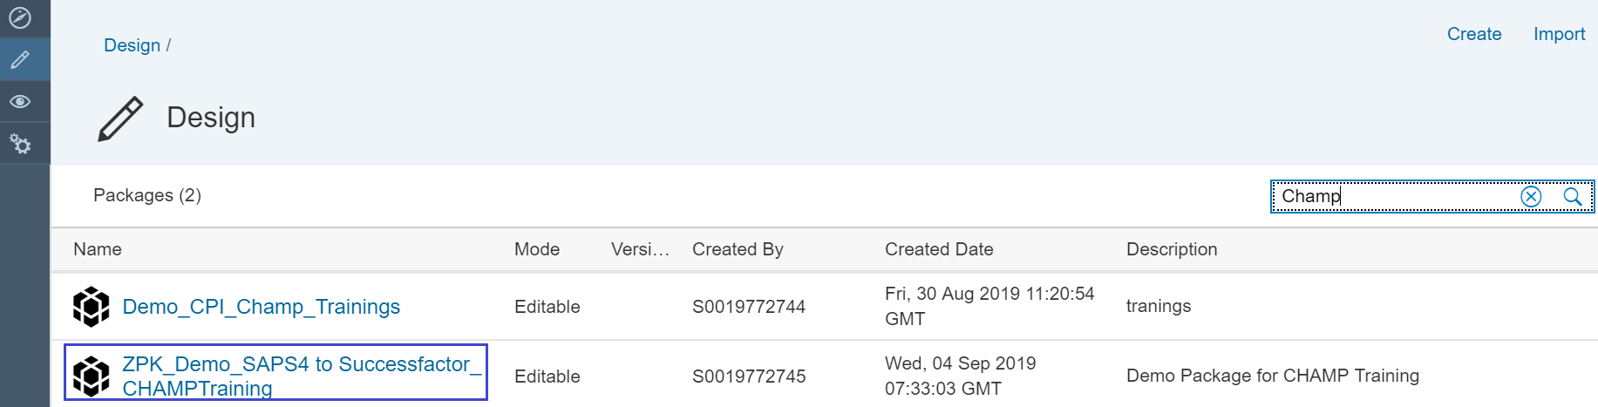
5. Creation of Package
Package can be created in Design page. To launch click the pointer marked in picture
Click Create in Design
Provide Package name, Short description
Click Save
Package is created and searched using Keyword

Slide 9
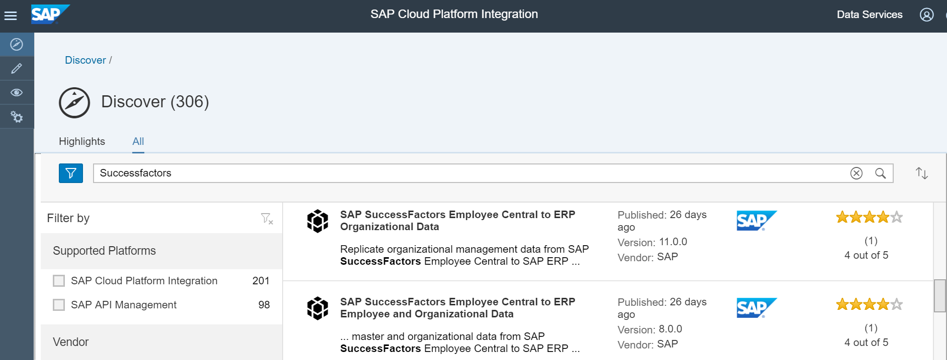
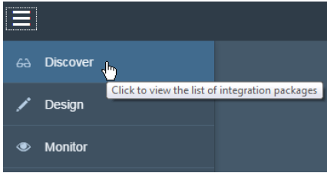
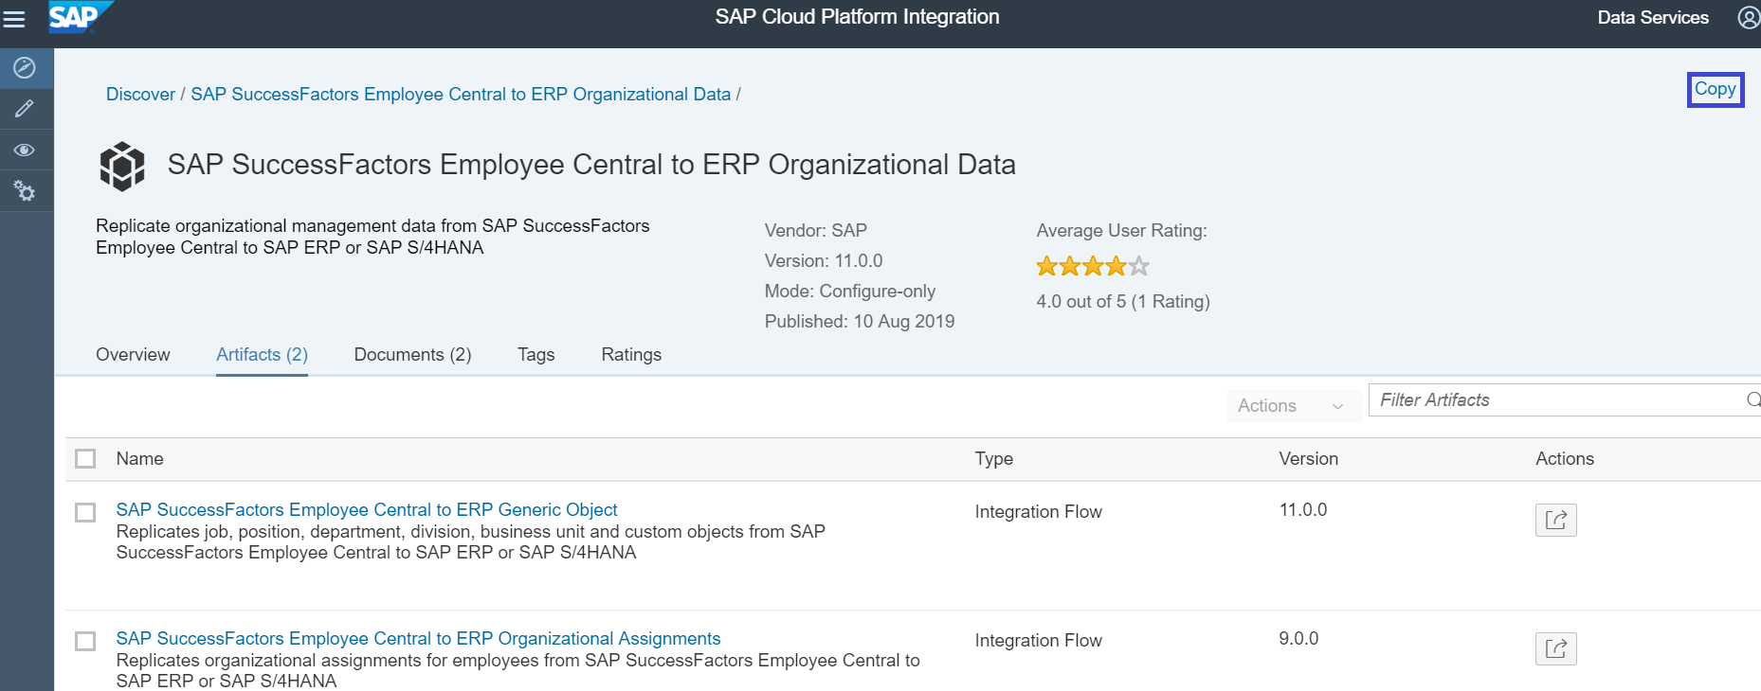
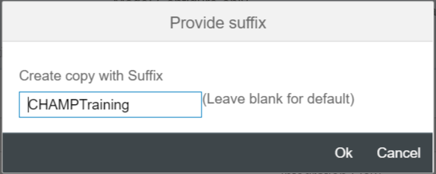
Prepackage Content Configuration
Steps to configure Pre-package Content Successfactor Employee Central to ERP Employee Data
Apply Filters
Select the Package
Copy to Own Workspace
Provide Suffix

Slide 10
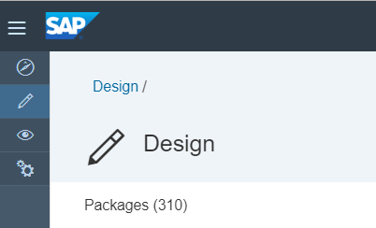
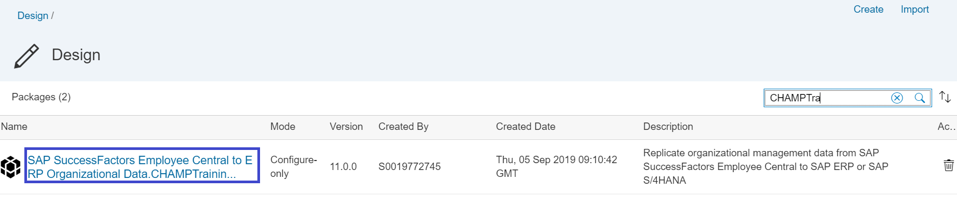
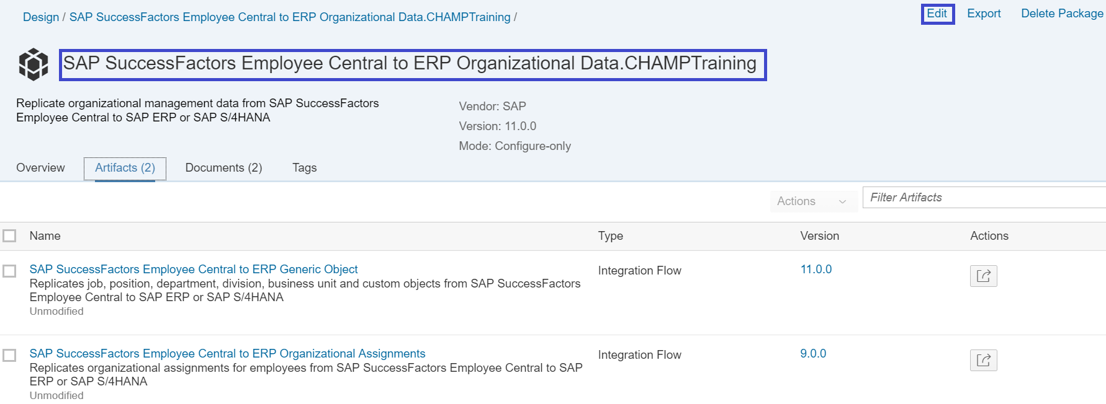
Prepackage Content Configuration
Package is added to Own workspace with Prefix and Editable

Slide 11


